Slide 1
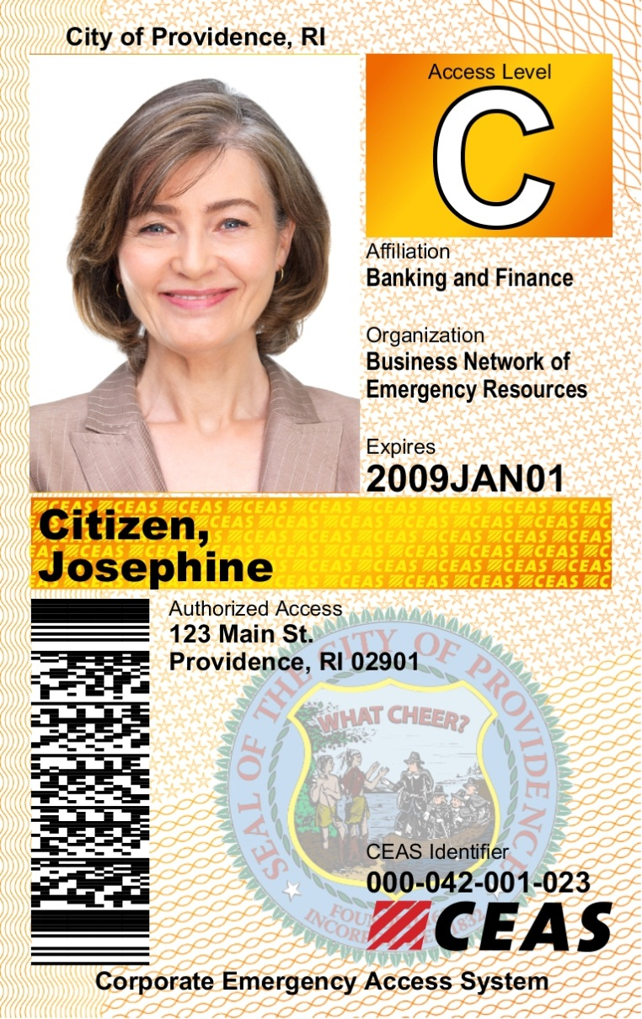
OFFICERS SHOULD INSPECT THE FOLLOWING CARD FEATURES TO DETERMINE AUTHENTICITY:
Program Region – Indicates the jurisdiction of issue
Access Level –ensure card corresponds to announced level of activation (Access Level B or C)
Photo – ensures identity of the cardholder
Industry Affiliation – Indicates business sector affiliation
Organization Name - Shows name of employer
Expiration Date – ensures validity of card
Cardholders Name - can be held against a second form of ID if necessary
Security Features-
Holographic laminate (not shown) embedded with the “CEAS” logo across the card
Micro text lettering and design pattern in the cardholders name panel with the “CEAS” logo
Access Address – ensure location is within the restricted area being accessed.
City Seal – Should be consistent with the program region name at the top of the card
CEAS logo, Indentifier and Bar Code – This identification number/bar code if checked electronically will authenticate the validity of the card
City of Providence, RI - Card Description
Front

Slide 2
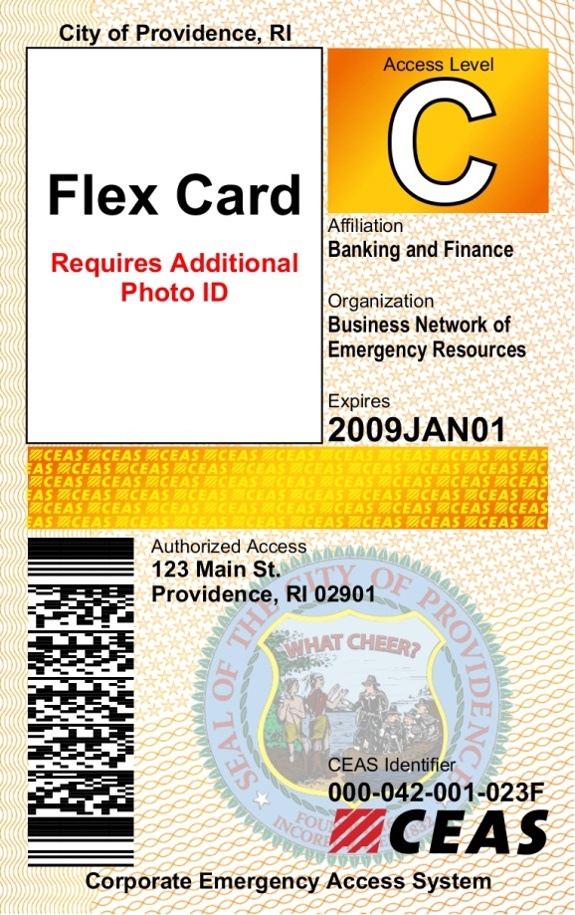
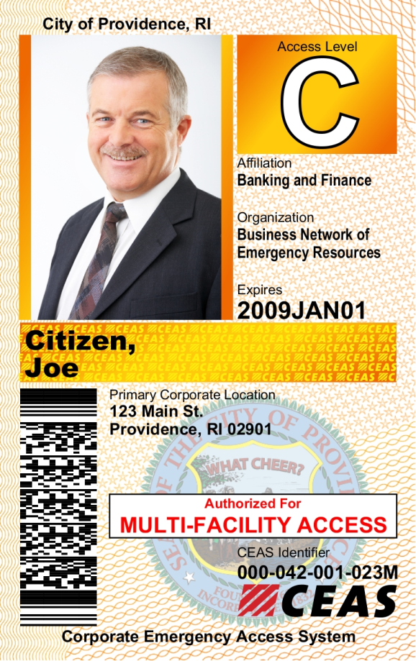
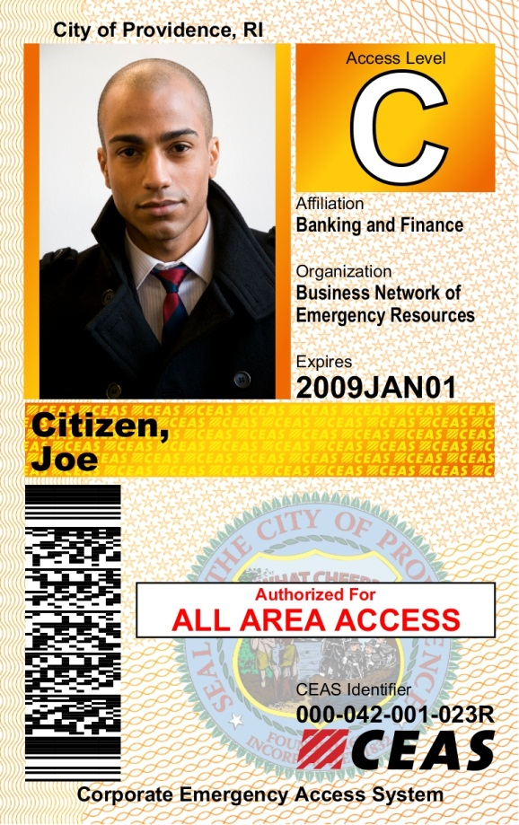
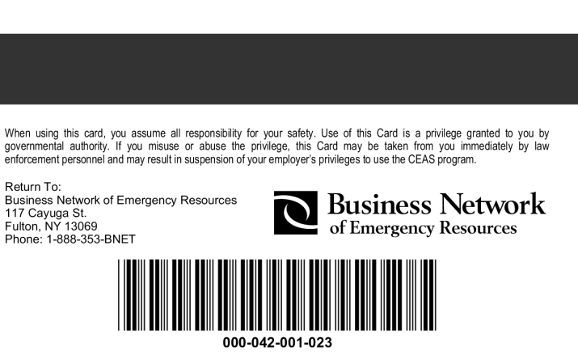
Flex Card
Have no photograph but are assigned to a specific company. The Flex Card MUST be accompanied by another form of government issued photo identification and/or proof of employment by the Organization listed on the face of the Card.
Multi-Facility Card
Indicates the Cardholder is authorized to access more than one facility. The card will display the primary company address. Additional facility addresses can be verified through BNET if necessary.
All Area Access Card
Indicates that the cardholder’s entry is NOT address restrictive.
Card Back
The back of all CEAS cards contain a disclaimer, the BNET logo, magnetic stripe, bar code and return address. The serial number at the bottom of the card should be the same as the CEAS identifier on the front

