Slide 1
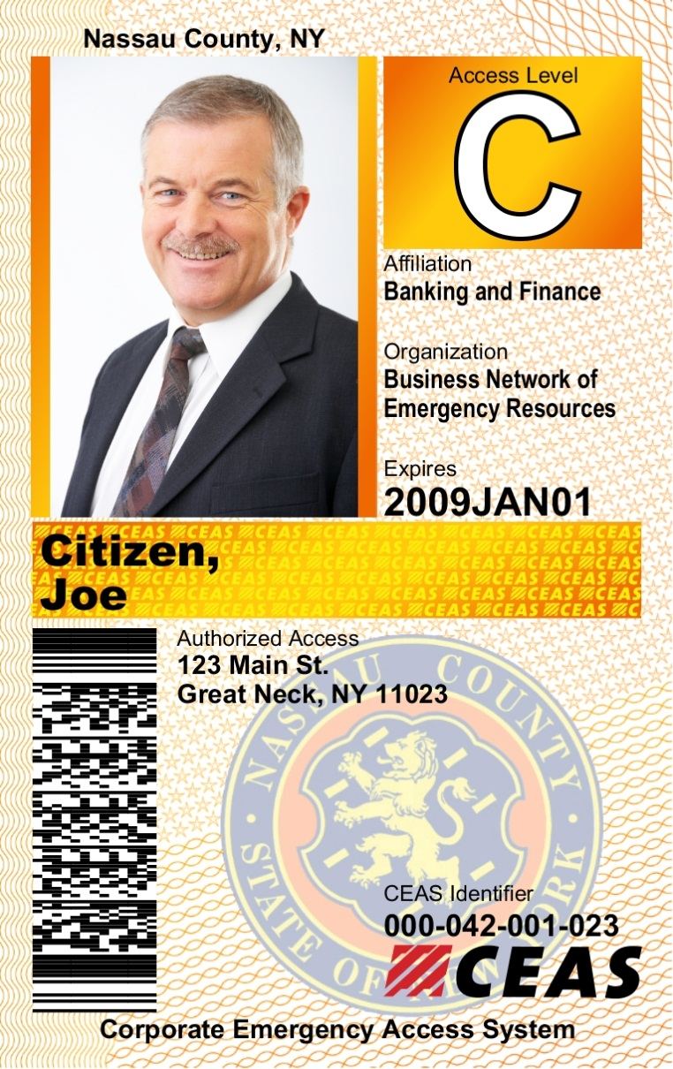
OFFICERS SHOULD INSPECT THE FOLLOWING CARD FEATURES TO DETERMINE AUTHENTICITY:
Program Region – Indicates the jurisdiction of issue
Access Level –ensure card corresponds to announced level of activation (Access Level B or C)
Photo – ensures identity of the cardholder
Industry Affiliation – Indicates business sector affiliation
Organization Name - Shows name of employer
Expiration Date – ensures validity of card
Cardholders Name - can be held against a second form of ID if necessary
Security Features-
Holographic laminate (not shown) embedded with the “CEAS” logo across the card
Micro text lettering and design pattern in the cardholders name panel with the “CEAS” logo
Access Address – ensure location is within the restricted area being accessed.
City Seal – Should be consistent with the program region name at the top of the card
CEAS logo, Indentifier and Bar Code – This identification number/bar code if checked electronically will authenticate the validity of the card
Nassau County, NY - Card Description
Front

Slide 2
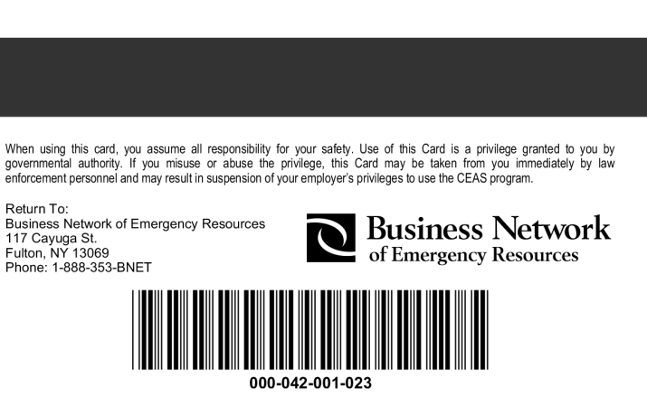
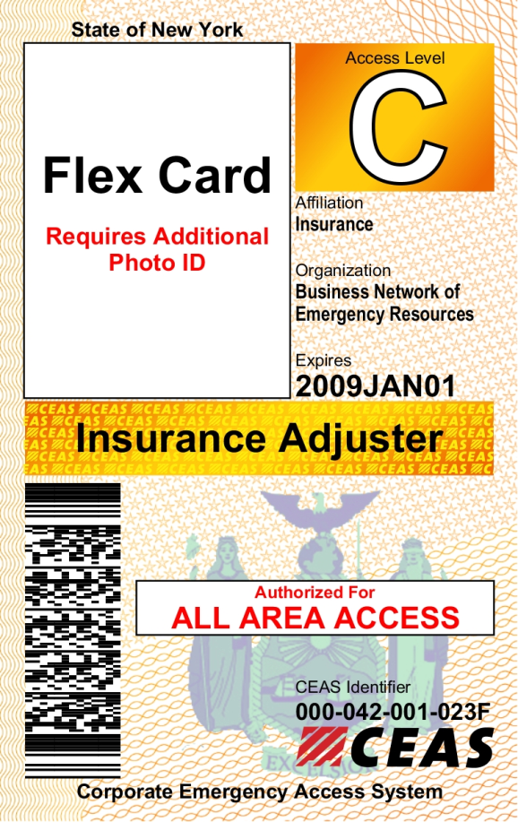
Nassau Co., NY - CEAS Card Description
Card Back
The back of all CEAS cards contain a disclaimer, the BNET logo, magnetic stripe, bar code and return address. The serial number at the bottom of the card should be the same as the CEAS identifier on the front
NYS Insurance Adjuster
In cooperation with the NYS Insurance Department a limited amount of Insurance Adjuster CEAS cards have been issued to companies that insure property in New York State. These cards are generic in nature and must be accompanied by identification from the employer listed in the “Organization” field on the card.

