Slide 1
Awareness Training For Law Enforcement Agencies

Slide 2
OVERVIEW
Purpose
Training Objectives
Authority
Definitions
CEAS Cards Types/Variations
Verification and Inspection of Cards
Enforcement Guidance and Summary

Slide 3
PURPOSE
The private sector owns and operates 85% of our national critical infrastructure and community lifelines.
Travel and access restrictions are common during emergencies.
Private sector employees must have the ability to travel and access facilities during emergencies.
The CEAS program is a Crisis Event Access Control program that provides a centrally issued, common credential (CEAS Card) to help law enforcement easily identify these employees.

Slide 4
TRAINING GOAL / OBJECTIVES
The Goal of this training is to provide guidance for law enforcement officers in identifying and validating critical private sector employees using the CEAS card during times when travel/access when restrictions are in effect due to an emergency.
Objectives
Familiarize members with the CEAS program and credentials.
Provide a basic understanding of the purpose of the program.
Assist law enforcement officers in identifying critical private sector employees using the CEAS card
Provide a process for authenticating those employees
Provide guidance to facilitate cardholder travel and access to areas restricted to the public during an emergency

Slide 5
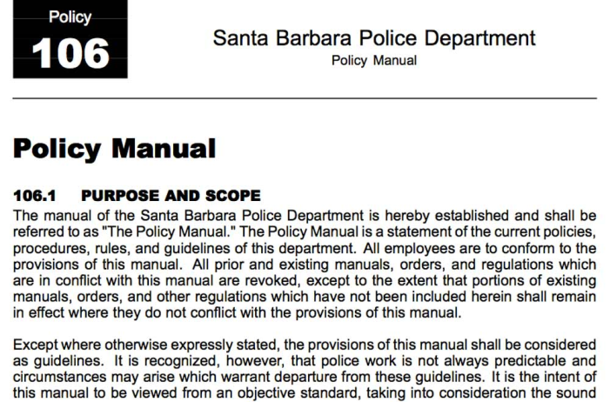
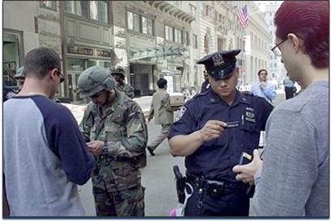
AUTHORITY
Executive Order
Department Policy
Situational Discretion

Slide 6
DEFINITIONS
Access Point: The location at which CEAS Cardholders will gain access to a restricted area
Access Level: There are three (3) fundemental Access levels in the CEAS Program
Level C: Critical Employees and Essential Service Providers of Critical Infrastructure
Level B: Critical Employees and Essential Service Providers of all businesses
Level A: Vehicular restrictions, CEAS Cardholders (any) are authorized to utilize a motor vehicle (Level “A” is not a designated access level in Massachusetts or Rhode Island statewide programs)
BNET: The Business Network of Emergency Resources, administrators of the CEAS Program
Cardholder: A private sector employee in possession of a CEAS Card
CEAS Card: A credential authorized by the [City/County/State] to help identify critical business employees
Critical Employees: Employees deemed necessary to the businesses recovery and survivability of a private sector organization
Perimeter: The boundary of the restricted area to which members of the department may be assigned to prevent unauthorized individual access
Restricted Area/Roadway: An area or roadway evacuated due to an emergency event access to the general public in not permitted.
Sponsoring/ Issuing Jurisdiction: A governmental jurisdiction that permits access to restricted areas within their geographic boundary through the use of a CEAS card

Slide 7
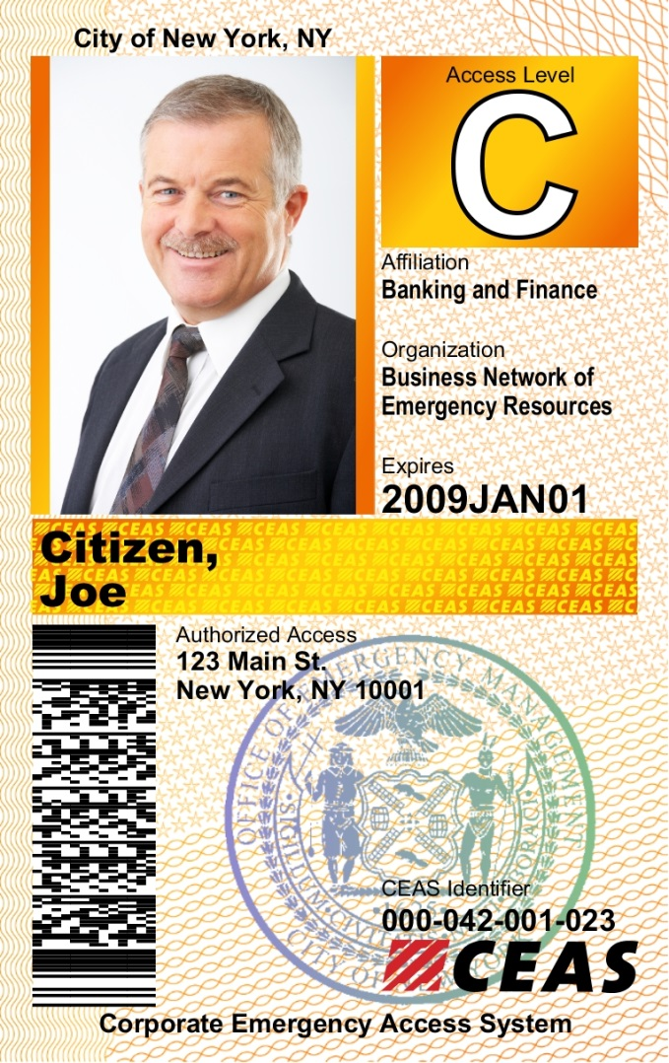
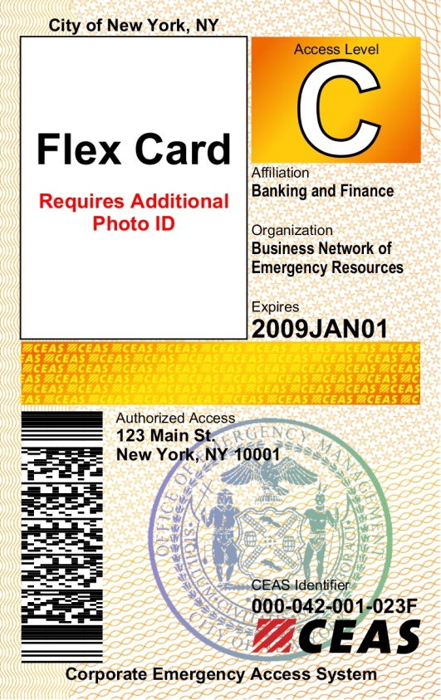
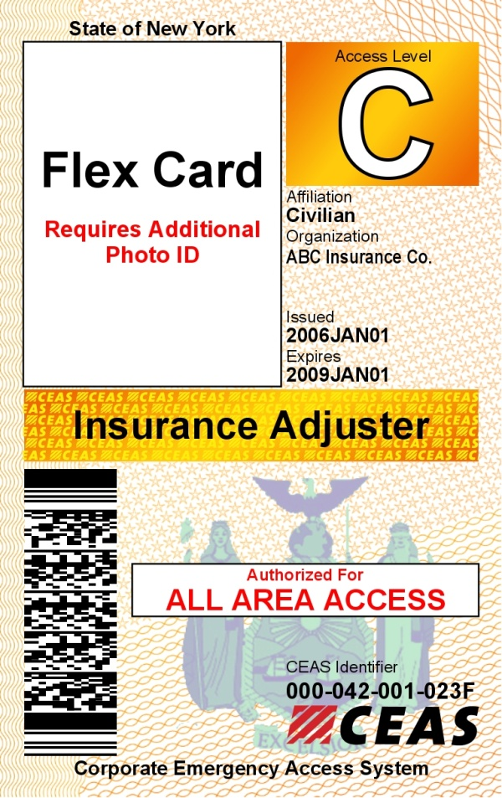
CEAS CARDS
STANDARD CARD
FLEX CARD
INSURANCE ADJUSTER CARD
(New York State Only)
No photograph
Address Specific
Organization specific
MUST be accompanied by another form of government or company issued photo ID
Companies vetted by the NYS Department of Financial Services (NYDFS)
Issued at the time of an event. All Area Access designation based on location uncertainty
Must carry additional company based ID
Photo ID
Address Specific
Organization Specific

Slide 8
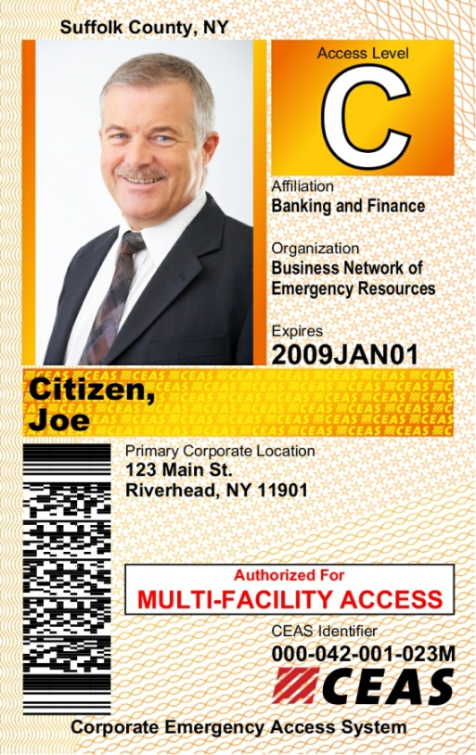
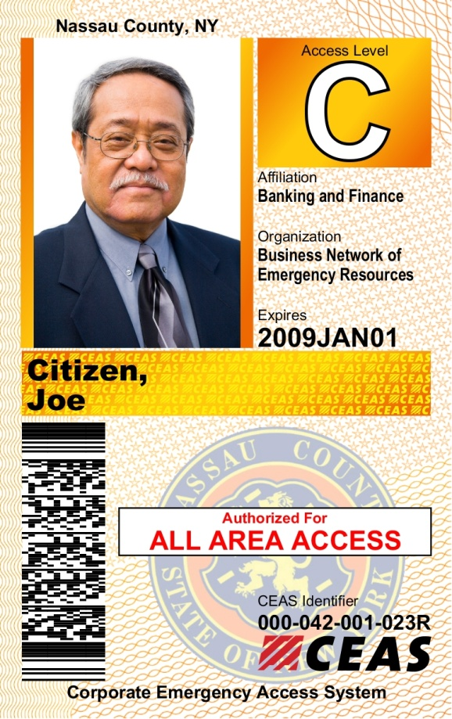
CEAS CARD VARIATIONS
Multi-Facility Card
(Not used in Statewide Programs)
All Area Card
(Not used in Statewide Programs)
Issued to Employees requiring access to more than one company facility within the region.
Primary work site listed on the card additional facilities can be confirmed, if necessary, via electronic scanning or through verbal confirmation.
Issued to a specially defined group of industries that provides access anywhere within a restricted area . All Area Cardholders are pre-screened by the County for this special access

Slide 9
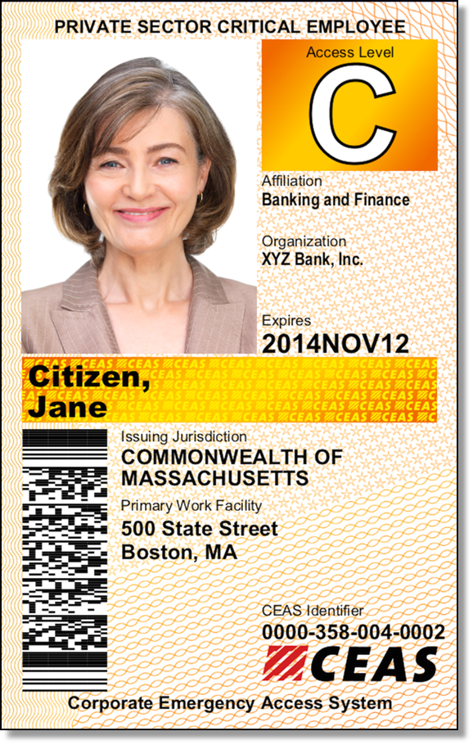
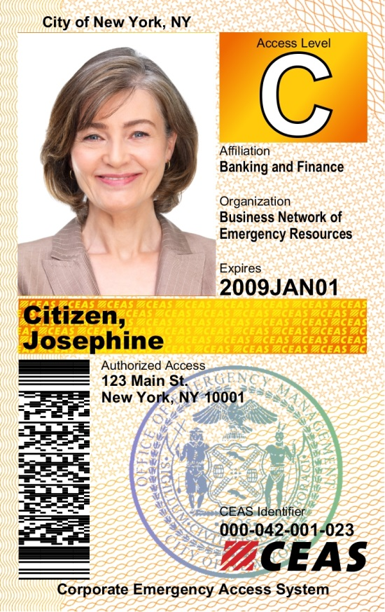
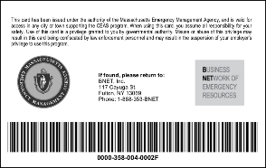
CARD VARIENCES
Statewide / Interoperable Program Card
Local Jurisdiction Card
On Interoperable Programs Only
Issuing/Sponsoring Jurisdiction
Government Seal
On Rear

Slide 10
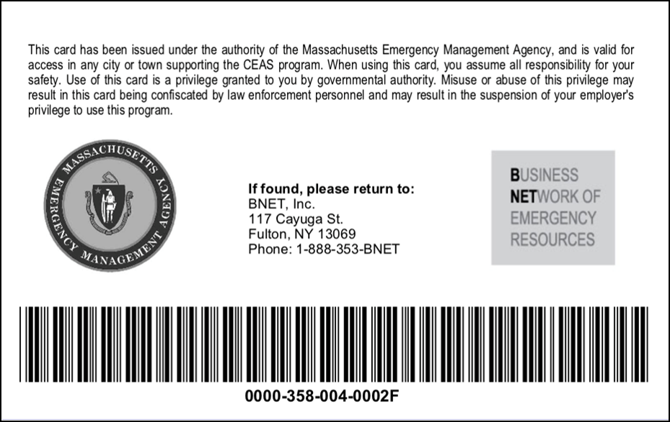
VISUAL INSPECTION
All CEAS cards should have the following components on the rear of the card:
Cardholder Terms of Use
Sponsoring Jurisdiction Seal – (Only used in Statewide program)
BNET Phone Number – Can be used to verify a card
Linear Bar Code/CEAS Identifier – The bar code contains the CEAs Identifier, which can be scanned to validate the card at a checkpoint. The CEAS identifier should match the one on the front of the card.
CARD BACK – ALL CARDS

Slide 11
VERIFICATION
Visual Inspection
Electronic Verification
Verbal Verification

Slide 12
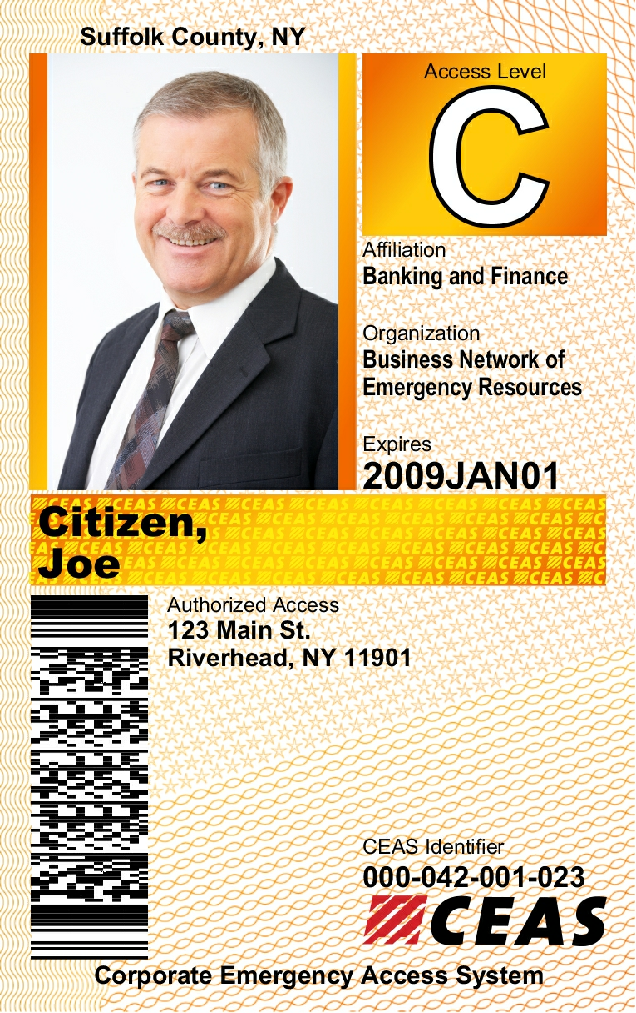
VISUAL INSPECTION
OFFICERS SHOULD VISUALLY INSPECT THE FOLLOWING CARD FEATURES TO DETERMINE AUTHENTICITY:
Access Level –ensure card corresponds to announced level of activation
Photo – ensures identity of the cardholder
Industry Type – Identifies the industry type in the event is access is further restricted by this qualifier
Organization Name: Shows company of employment
Expiration Date – ensures validity of card
Cardholders Name: - can be held against a second form of ID if necessary
PDF 417 Barcode– Can be scanned by CEAS Mobile App to verify authenticity
Security Features-
Micro Text embedded in face of card
3D Holographic Laminate (not shown)
Hologram can be seen when the card is tilted to the light.
Front

Slide 13
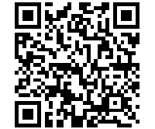
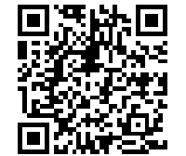
ELECTRONIC VERIFICATION
CEAS Cards can be verified Electronically by:
Desktop, laptop (PC Interface)
iOS or Android Smartphone
iOS or Android Tablet
Mobile Apps can be downloaded from the App Stores by searching “CEAS Mobile” or by scanning the QR codes below:
Additional training resources for the use of the CEAS Mobile App can be found on the CEAS Website at :
http://www.ceas.com/law-enforcement/

Slide 14
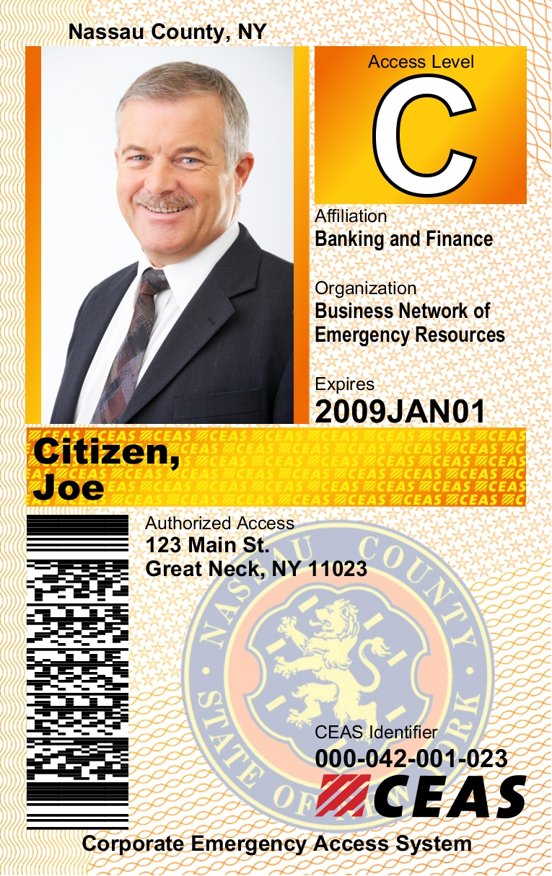
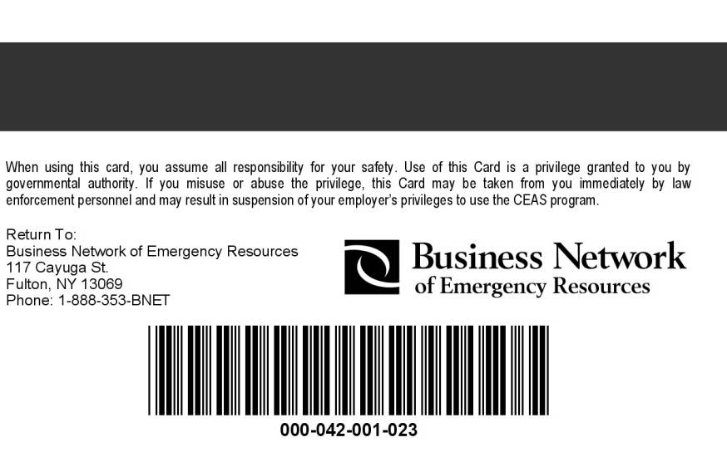
VERBAL VERIFICATION
CEAS Cards can be verified verbally by calling 888-353-2638 and providing the CEAS Identifier number found on the front and rear of the card. Radio dispatchers or operations centers can verify cards via desktop or laptop for radio or phone based confirmation.
By Phone
Operations or EOC
BNET Support

Slide 15
ENFORCEMENT GUIDANCE
IF CEAS IS ACTIVE IN YOUR JURISDICTION AND YOU ARE PRESENTED WITH A CEAS CREDENTIAL WHILE:
Making a car stop on a restricted highway or roadway and presented with CEAS Credential, or
Assigned to an incident outer perimeter, or;
Assigned to an inner perimeter Access Point
ACTIONS
Visually confirm the users access level is authorized
Proceed with Visual, Electronic or Verbal Verification of presented CEAS credential
If card is verified, you may at your discretion permit travel/entry
If card is invalid, you may deny entry and/or confiscate card

Slide 16
ENFORCEMENT SUMMARY
Officers may ALWAYS exercise discretion when by denying or permitting travel/access based on need and situational awareness
You may deny access/travel at any time if card/cardholder fails to meet the verification tests.
All expired/invalid cards may be confiscated and reported to BNET at 888-353-BNET (2638)

